Slide 1

Eventable Change Management Guide
- By Team 2: Wenfeng Zhuo IV, Ray Anthony Roderos, Zhiyu He

Slide 2

Contents
01
Problem Statement
02
Methodology
03
Findings & Dashboard
04
Solutions and Actions
05
Change Management Guide

Slide 3
01
Problem Statement

Slide 4


1
Problem Statement
Problem Statement and Objectives
1. We want to find out which factors that are within Eventable's control can contribute to their Client's event performance.
2. What events are the most similar in characteristics and what are their performance metrics?
3. What business strategy can we come up with this?
Eventable has good quality analytics and are performing well at current stage. However, it needs to explore more opportunity for future growth and foster sustainable competitive advantages to keep its leading position and dominate in the market.
Capstone Project: Eventable

Slide 5
02
Methodology

Slide 6
2
Methodology
Here are some challenges we had when we were doing this project
Missing Data
(no information on users)
How to join table
How to find performance metrics
How to create dashboard
How to interpret results
How to provide strategies & suggestions
Capstone Project: Eventable

Slide 7



2
Methodology
Combining and comparing performance metrics allows us to define high performance events and then find out their common characteristics.
Subscribers
Characteristics
The total number of subscribers for each event
Views
The total number of updates the event had, such as a change in time
2
1
The total number of times that customers check out the specific event on their calendar
Time
The time period of events:
Day in week
Start Date: DD/MM
Ping Count
6
Performance
Metrics
(Variables)
Location
3
Super Users
The location of events:
City, Country
Time Zone
The total number of times that the event is shared on social media
The top 25% subscribers in term of calendar view
Low Users
4
Social Shares
5
Category
Bottom 25% subscribers in term of calendar views
N.A.
Capstone Project: Eventable

Slide 8
2
Methodology
Clustering Technique: K-Means will determine which events should be grouped and categorized together
Unsupervised
No pre-existing category
labelled
to
each
event
K-Prototypes
Better handle
categorical
and
numerical
data
Step 1:
Take the characteristics of the events and merged them with their performance metrics as the final dataset
K-Means
(an unsupervised clustering algorithm)
Step 2:
Use K-Means and K-Prototypes to cluster these events based on their characteristics
K-Means
To partition
events with similar characteristics
into K-Sets
K-Means
Determine
which events
are grouped or
categorized together
Step 3:
Analyze each cluster based on both characteristics and performance metrics to gain insight
Capstone Project: Eventable

Slide 9
2
Methodology
From the analysis of number of subscribers and number of views, we find that events have both high subscribers and views shares a set of characteristics.
Characteristics
Number of Views
(95, 2.8K)
Time
Thursday
End of May
Location
NYC, US
Eastern Standard Time Zone
Category
N/A
Number of Subscribers
Capstone Project: Eventable

Slide 10
03
Findings
and Dashboard

Slide 11

3
Findings and Dashboard
To make everything clear, we made a dashboard on Tableau.
Capstone Project: Eventable

Slide 12
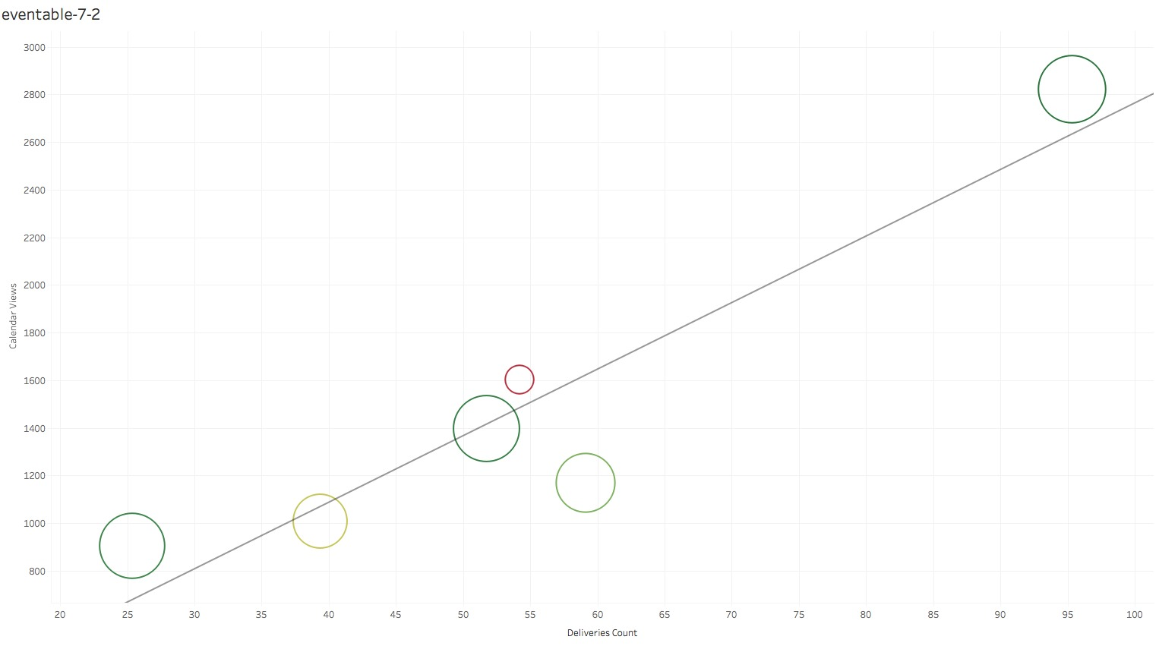
3
Findings and Dashboard
Proof of Concept – Tableau Visualization 1 – Subscribers VS Calendar Views 7 Clusters
Capstone Project: Eventable

Slide 13
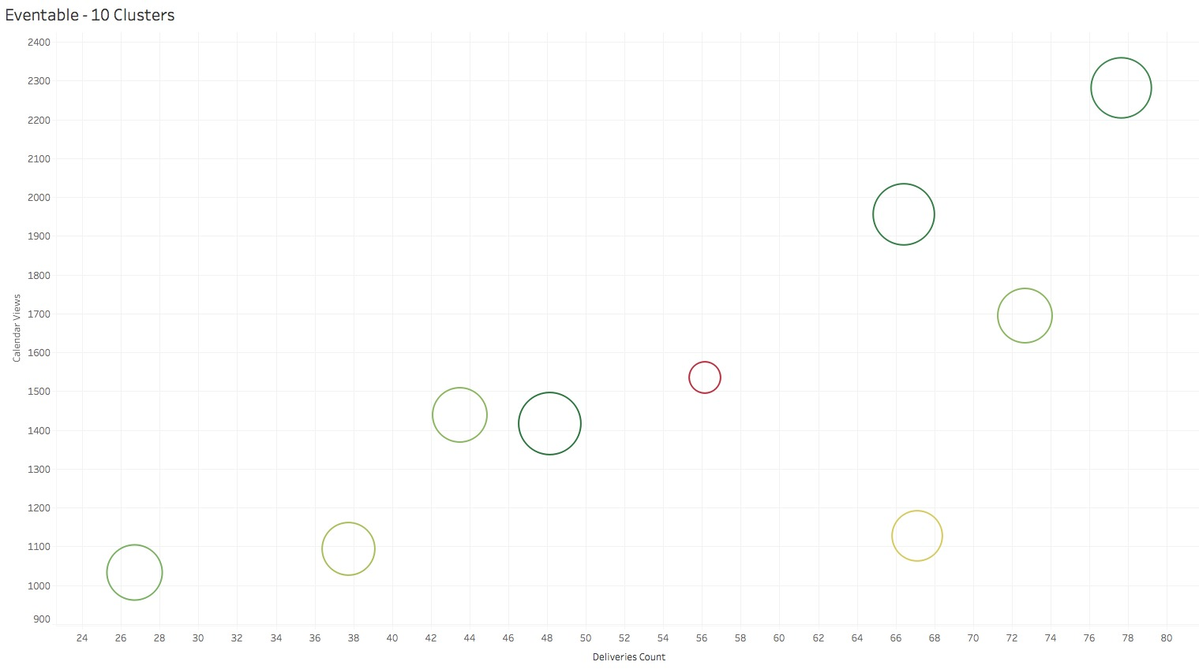
3
Findings and Dashboard
Proof of Concept – Tableau Visualization 2 – Subscribers vs Calendar Views 10 Clusters
Capstone Project: Eventable

Slide 14
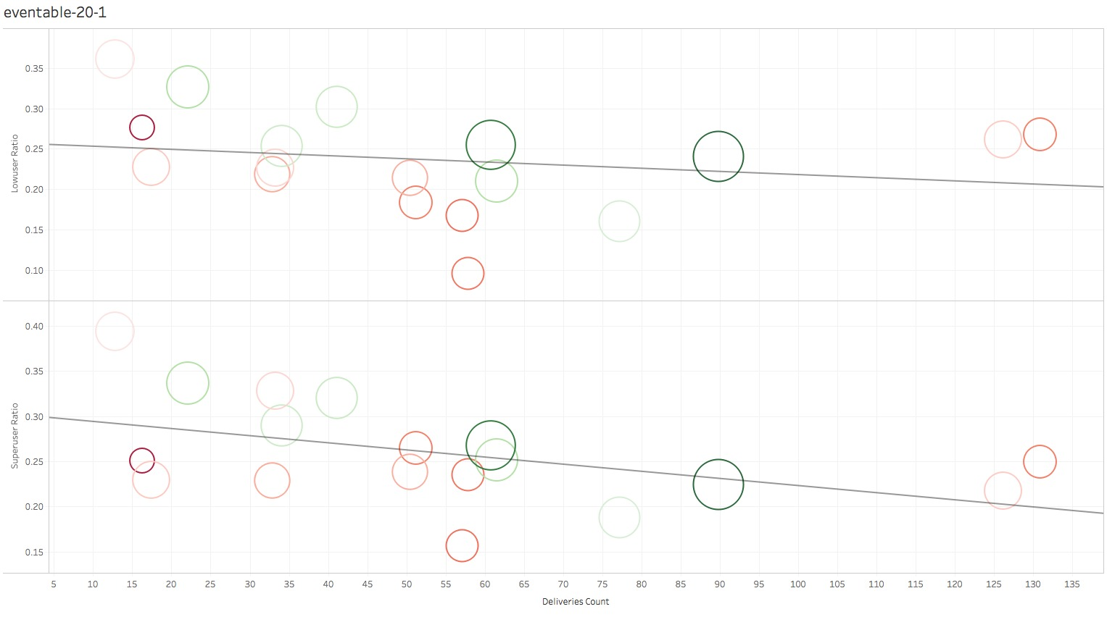
3
Findings and Dashboard
Proof of Concept – Tableau Visualization 3
LowUser Ratio and SuperUser Ratio VS Subscribers at 20 Clusters
Capstone Project: Eventable

Slide 15
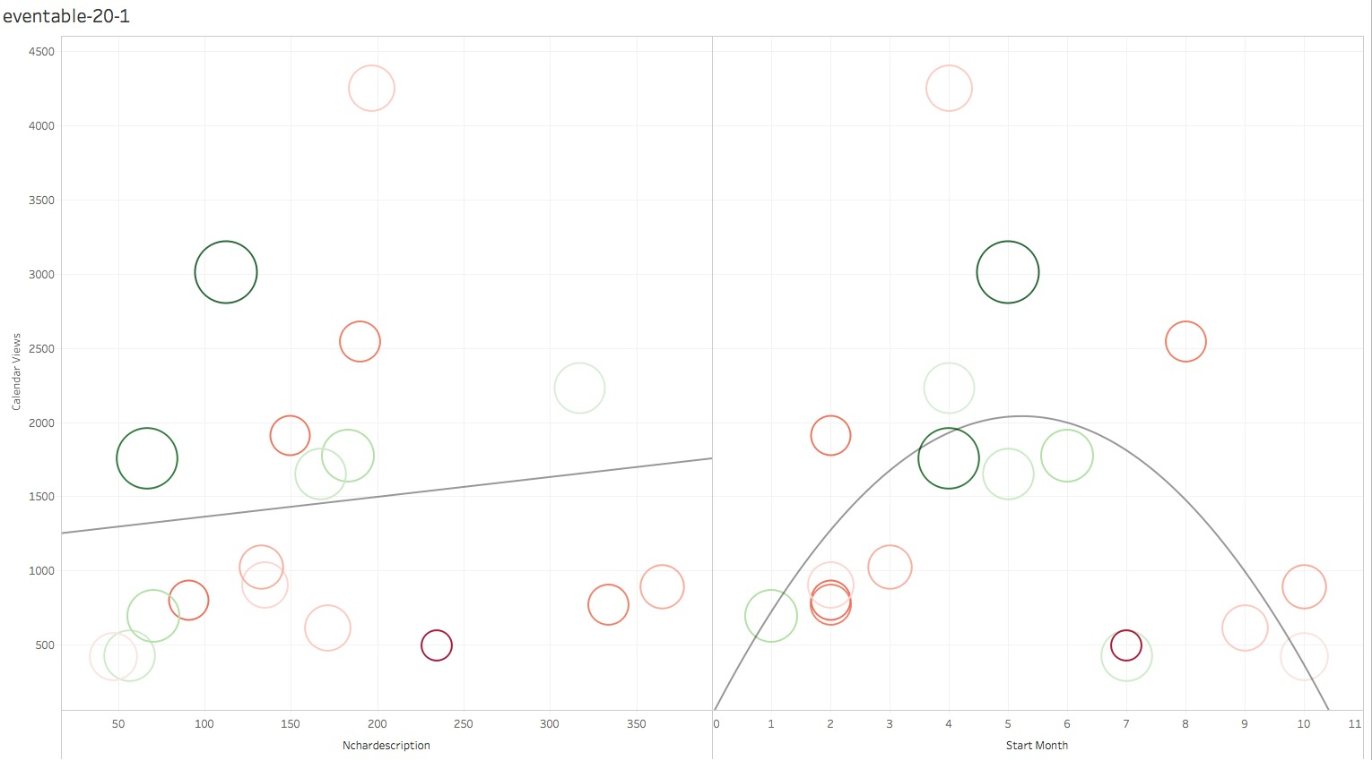
3
Findings and Dashboard
Proof of Concept – Tableau Visualization 4
Calendar Views vs NCharDescription and Start Month at 20 Clusters
Capstone Project: Eventable

Slide 16
3
Findings and Dashboard
With our approach to the analysis, we found various correlations among variables, and the number of subscriber becomes an important determinant factor.
Extract characteristics and performance from events
Use modified K-means to group similar events and study correlations among performance metrics
Finding 1: Uncontrollable Variables
Variables that are out of Eventable’s control such as time, place, date and so on have no correlation with event’s performance
Finding 2: Non-correlated Variables
There is no correlation with the number of high-performing users and low performing users with the number of subscribers
Finding 3: Correlated Variables
There is a correlation with the number of characters in the title and character descriptions to number of views. Good short titles with detailed descriptions keep subscriber’s interest high.
Finding 4: Highly Correlated Variables
There is a high correlation with both performance metrics, subscribers and calendar view.
Capstone Project: Eventable

Slide 17
04
Solution and Action

Slide 18

4
Solution and Action
By partnering with 3rd party programmatic platforms would allow us to use targeted Ads to reach out to more relevant consumers, and thus increase subscribers.
Targeted Ads
Eventable partners with many other platforms and websites to create targeted ads for the consumers on these platforms. These targeted ads would embedded with the ”Add to Calendar” feature. This allows your events to reach to a larger market, and increase the number of subscribers.
Partner with 3rd Party Platforms
More Subscribers
Target Ads
Capstone Project: Eventable
Capstone Project: Eventable

Slide 19
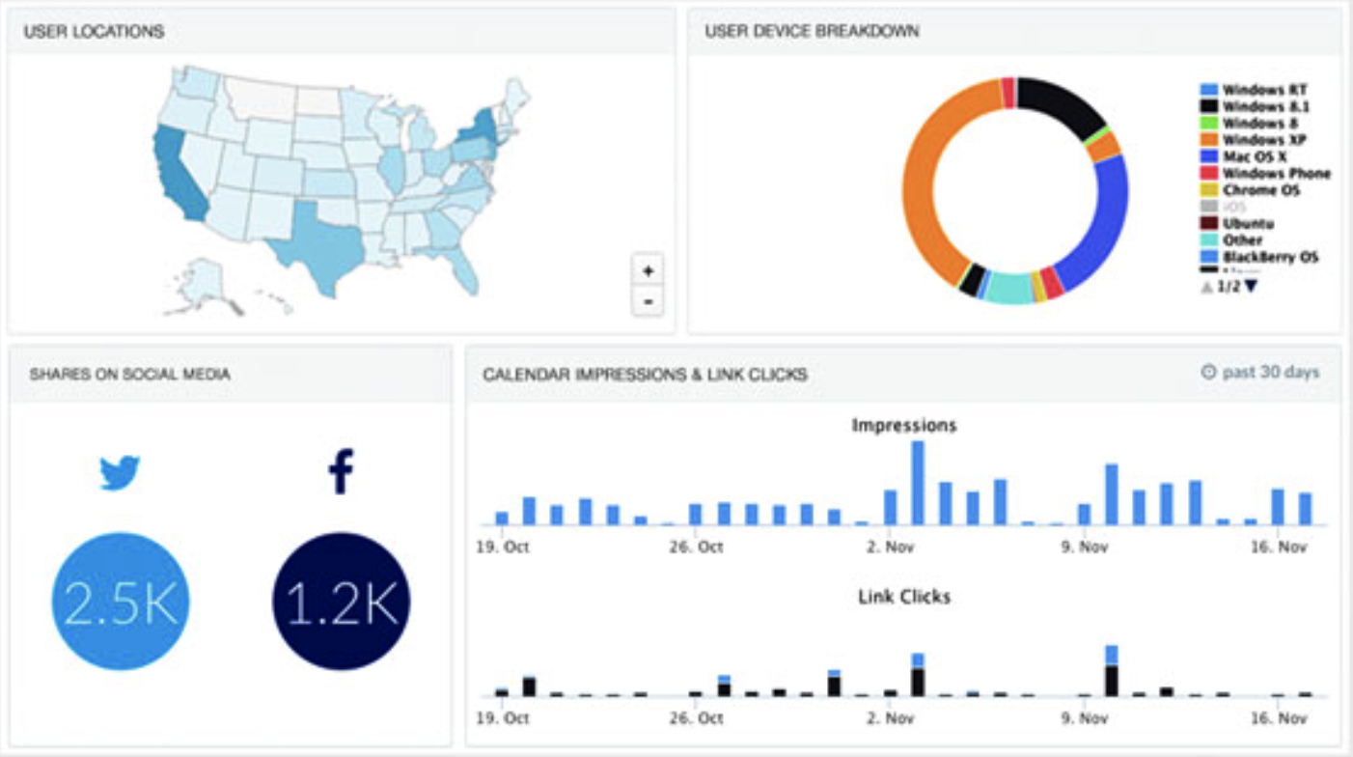
4
Solution and Action
In addition to Smart Analytics results, Dashboard Alert System allows you to be always up to date about any change in your customers’ behavior.
Updated about Any Change
点击输入内容
点击输入内容
点击输入内容
点击输入内容
Analyze Engagement
Identify High Performing Channels
Customer Demographics
Track & Optimize Outbound Activity
Capstone Project: Eventable
Capstone Project: Eventable

Slide 20







4
Solution and Action
30-Day Worry-Free Guarantee Program eliminates client’s worry and make them believe that their money spent worthy.
Worry-Free Guarantee
Eventable offers a 30-day worry-free guarantee program to all clients. Therefore, they do not pay anything upfront. They can try our service for the first 30 days. If they like it, like customers always do, they will definitely continue the contract. If for some reason not, they can cancel the service at any time without any additional fees.
Capstone Project: Eventable
Capstone Project: Eventable

Slide 21
05
Change
Management Guide

Slide 22
5
Change Management Guide
The solution and the change aims to improve Eventable’s competitiveness and improve revenue.
The solution is perfect for Eventable at this stage because while continuing refining the data analytics process, the quality of customer engagement is mostly based on the number of subscribers. While the current service is maintaining the good quality, Eventable needs to expand and take a step forward to help the customers to enlarge the number of subscribers, which would create a new competency and improve company competitiveness.
New Depart-ment
Change Process Mgmt
Acquire
Market Outreaching Talents
Service Integration
Capstone Project: Eventable

Slide 23

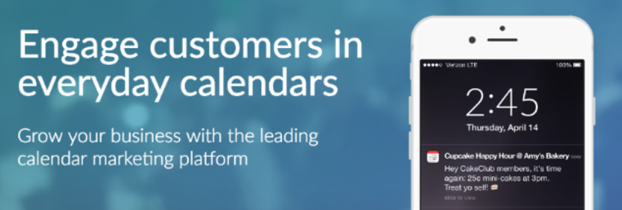
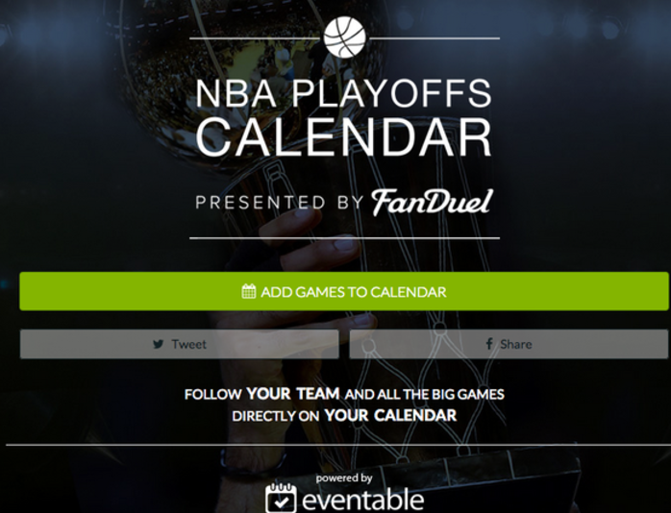


5
Change Management Guide
Creating advertisements that highlight the company, the services, and highlight the success achieved and the clients can achieve instead of paying for ads to target institutional clients.
Focusing on the
Company
Service
Event
Past success
Envision the future success for the clients and let them see their potential.
Capstone Project: Eventable

Slide 24
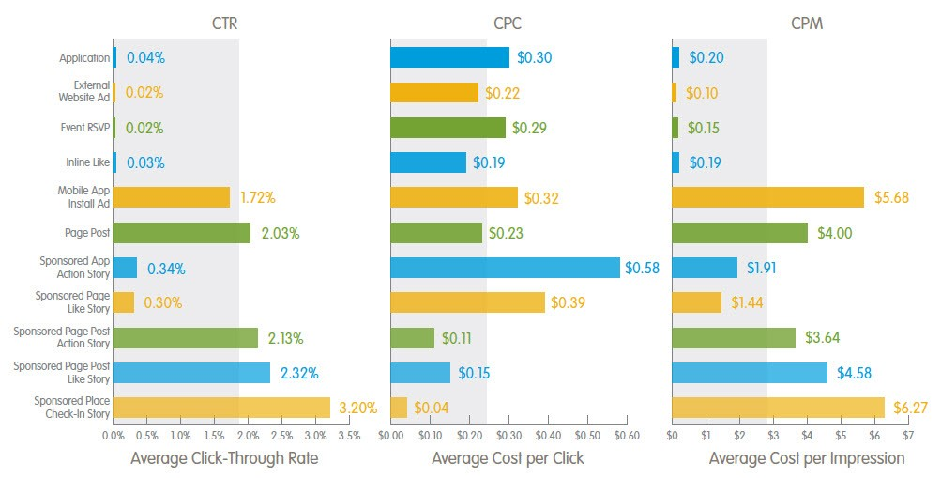
5
Change Management Guide
For example: Facebook Ads
Capstone Project: Eventable

Slide 25
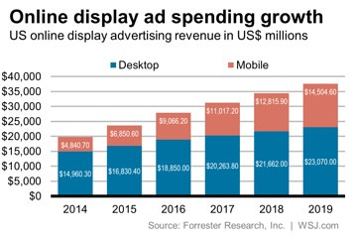
5
Change Management Guide
Companies are spending more and more on online display Ads, and it seems like they will spend more in the future because it brings them considerable amount of revenue.
Capstone Project: Eventable

Slide 26
5
Change Management Guide
Change process has to be smooth and it’s must be implemented completely, and adjusted consistently according to exact situation at each stage. All process should be centered on increasing subscribers. –Kotter’s 8 Step Change Model
Create Sense of Urgency
Build Guiding Coalition
Form Strategic Vision & Initiatives
Communicate the Vision
Identify potential threats of low subscriber growth and identify the change as a necessary element to maintain competitiveness
Identify influencing people in different group and ask for emotional commitment from them
Determine the values that are central to the change, and create a strategy that aims to increase subscribers
Openly & honestly talk about your change vision, and address people’s concerns & anxieties
Institute Change
Sustain Acceleration
Generate Short-term Wins
Remove Obstacles
Talk about the progress, and tell success stories about the change process; Publicly recognize key members of the change coalition; Communicate the success to clients
After hitting every subscriber target, analyze what went right and what needs improving, and then set goals to continue building on the momentum
Look for sure-fire projects that can be implemented without help from any strong critics to increase the subscribers fast at first
Identify or hire change leaders whose main roles are to deliver the change; Identify the resisting people and help them
Capstone Project: Eventable

Slide 27
5
Change Management Guide
In order to make sure that we are on the right track, the numbers of target ads, subscribers, engagement rate and clients are the key performance indicators.
01
Number of Target Ads
The number of Ads represents whether the partnerships are working and whether we have enough partnerships
02
Number of Subscribers
The number of subscribers directly represents the result of the new strategy and the implementation of the strategy.
03
Engagement Rate
Engagement is the core values that we provide to customers, and everything we do is to increase engagement
04
Number of Clients
The number of clients and the number of months they use our service directly relates to our revenue and profits, which is our financial supports
Capstone Project: Eventable

Slide 28
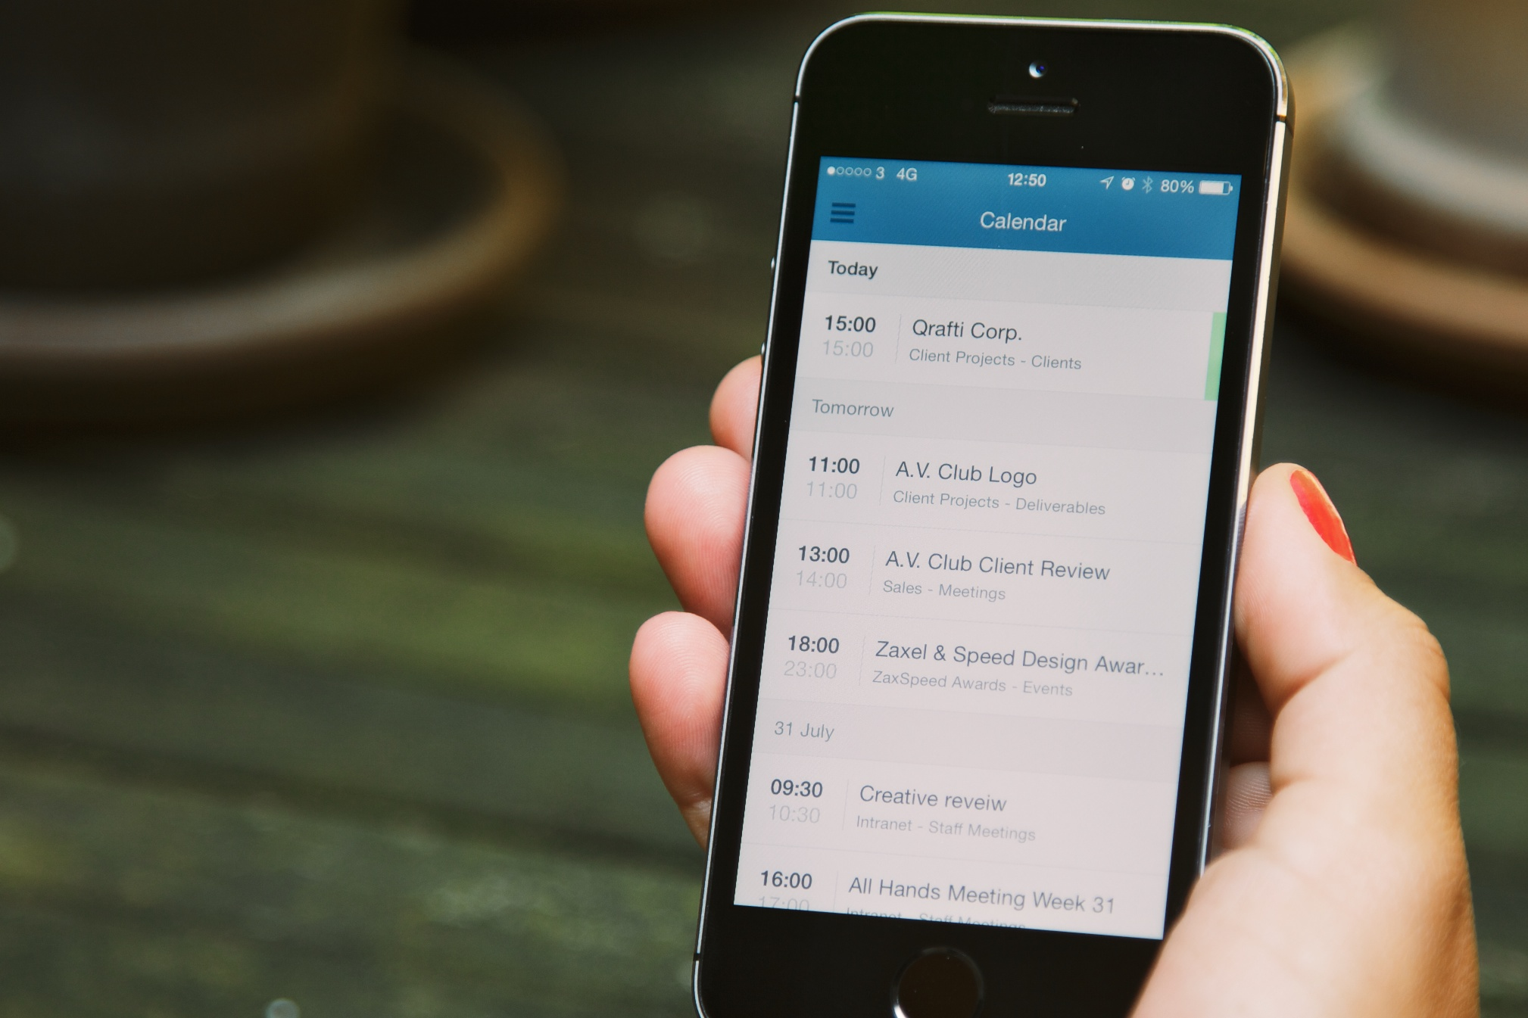
End
Thank you and we are open to all comments and questions now.
Thank
You
Capstone Project: Eventable

